Slide 1

Solutions for buyers
> Value proposition
> Benefits
> Features and functions
16 May 2022

Slide 2

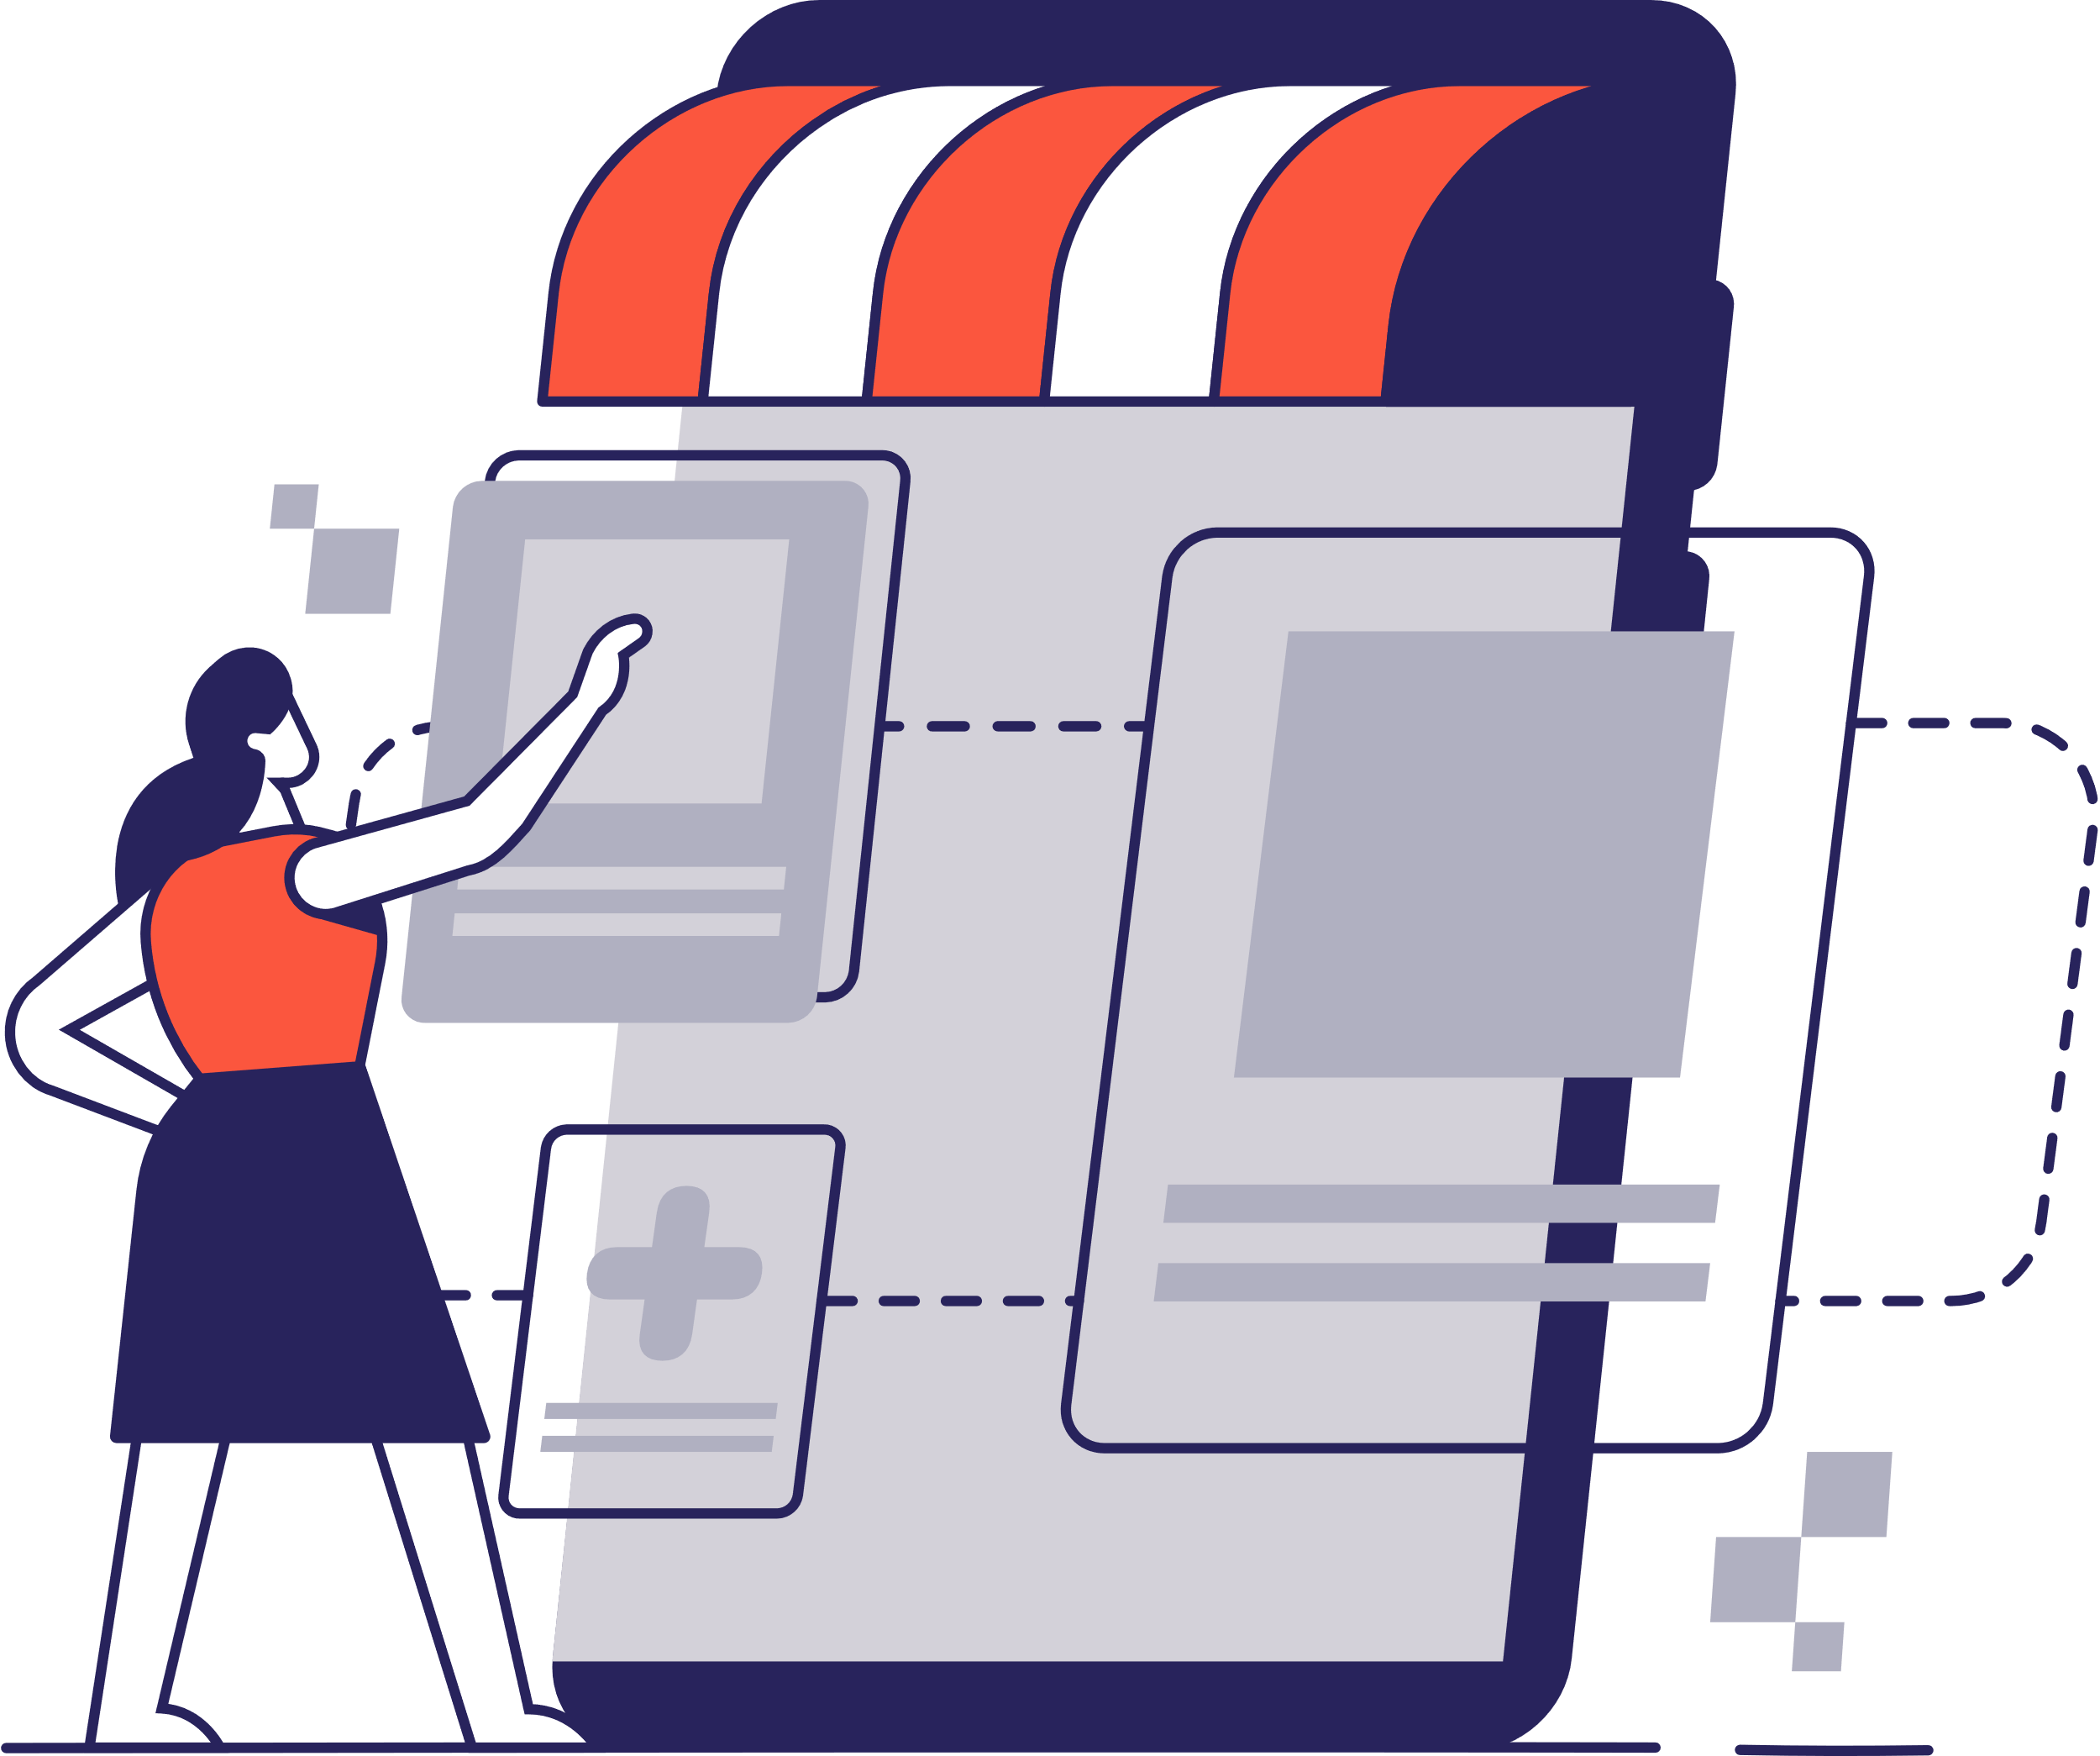
Value proposition
Unite is the only e-procurement platform with a B2B supplier network and an integrated B2B marketplace, our Spotmarket.
We offer products and services through one customisable
B2C-like buying experience.

Slide 3




Benefits
Our platform offers you many business benefits
Service the full spectrum of indirect spend
    Buy ad-hoc items and planned volumes
    Buy from our Spotmarket, Europe’s largest indirect B2B assortment of products
    Benchmark offers between direct suppliers and our Spotmarket
Build your supplier network
    Find and set-up multiple suppliers fast using our ‘activate‘ feature
    Develop direct value-led relationships by negotiating conditions of trade​
    Invite your own suppliers to join Unite
Standardise your P2P processes
    Streamline search, ordering and invoicing
    Control maverick spending and ad-hoc buying
    Bundle payments with account payable automation and e-invoicing
Mitigate risks
    Uphold European data sovereignty with a platform made in Germany
    Embrace sustainability goals relating to localism and environmental standards
    Order from pre-qualified and vetted suppliers

Slide 4

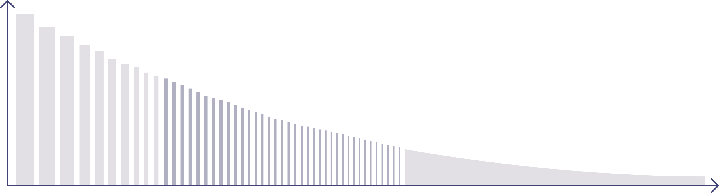

We cover the full spectrum of indirect spend
Supplier relationship
Strategic | Tactical | Transactional
Core demand | Repetitive demand | Long-tail demand
Search costs
Costs for supplier maintenance and framework agreements
Order volume/value
Number of suppliers

Slide 5
Two ends of the indirect spend curve
Existing solutions
    Strategic: contractually bound suppliers with a high order volume. Direct integration via own e-procurement system is justified.
    Transactional: suppliers with low order volumes. Here, buyers often use different online shops to handle demand for a wide range of products.
Supplier relationship
Strategic | Tactical | Transactional
Core demand | Repetitive demand | Long-tail demand
Direct integration | Digital gap | No integration, no one-to-one relationship
One-to-one supplier relationships. Access via punchout or own e-procurement system. |  | Buying from online shops with different logins, often unknown to procurement team. Lack of compliance encourages maverick spending.
Search costs
Order volume/value
Tail end
Number of suppliers

Slide 6

Two ends of the indirect spend curve
The digital gap
    Tactical: important suppliers but often not yet digitally connected
    This is where most free text orders are placed because these suppliers cover repetitive demand
    Without an overview of tactical purchasing, it’s impossible to manage spend or drive a procurement strategy
Supplier relationship
Strategic | Tactical | Transactional
Core demand | Repetitive demand | Long-tail demand
Direct integration | Digital gap | No integration, no one-to-one relationship
One-to-one supplier relationships. Access via punchout or own e-procurement system. | Existing and new relationships. Expensive and time-consuming digitisation. | Buying from online shops with different logins, often unknown to procurement team. Lack of compliance encourages maverick spending.
Search costs
Order volume/value
Tail end
Number of suppliers

Slide 7
Unite covers the full spectrum of indirect spend
Supplier relationship
Strategic | Tactical | Transactional
Unite Network
Spotmarket
Single Creditor*
Order volume/value
* Single Creditor available depending on the chosen transaction type
Individual contract
Standard contract
Marketplace contract
Number of suppliers

Slide 8
Unite covers the full spectrum of indirect spend
Supplier relationship
Strategic | Tactical | Transactional
Unite Network
Spotmarket
Single Creditor*
Order volume/value
* Single Creditor available depending on the chosen transaction type
Individual contract
Standard contract
Marketplace contract
Accessible through one customisable B2B marketplace with a B2C-like buying experience
Number of suppliers

Slide 9




Better business buying
Activate
Procure
Buy
Pay
Analyse
Find, activate suppliers and build your network.
Optimise procurement and steer internal demand.
Customise your B2B marketplace and decide how to shop.
Capture indirect spend and simplify reconciliation.
Get insights and support from ecosystem specialists.

Slide 10

Better buying for business
Activate
Find, activate suppliers and build your network.

Slide 11



Activate
Build your supplier network
Find suppliers
    Activate pre-integrated BusinessShops of pre-qualified B2B suppliers in the Unite Store
    Choose from a growing number of suppliers*
Invite suppliers
    Invite your preferred suppliers
    to join Unite
    Give your business access to personalised product assortments
    on negotiated terms
Manage suppliers
    View information about suppliers and framework agreements
    Manage contracts, contacts and billing data
Go to Unite Store
Invite suppliers
* The number of suppliers varies by market

Slide 12

Activate
Build your supplier network
“Setting up new suppliers caused us large amounts of admin effort in the past. Now we can add suppliers to our network and adapt it to suit our needs. This has also truly helped us in going digital. It’s a completely revolutionary way of handling indirect spend.”
Ralph Ulmer, Head of Corporate Purchasing and Executive Vice President of Hoerbiger Germany

Slide 13
Better business buying
Activate
Procure
Find, activate suppliers and build your network.
Optimise procurement and steer internal demand.

Slide 14


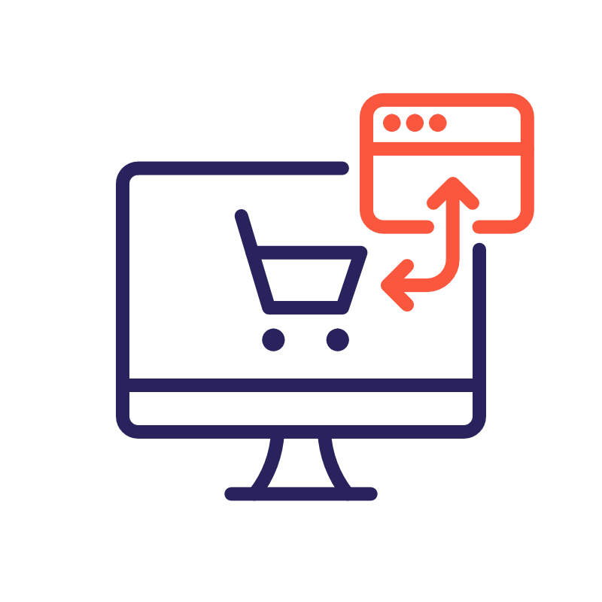

Procure
How you can access the Unite platform
  Web-based:
  start now
  SMEs or corporations that don’t have their own e-procurement system and want a quick set-up can use our Mercateo Procurement Portal.
  Via Punchout:
  from your system
  Companies with an existing
  e-procurement system can punch out (cXML/OCI) to our Mercateo Procurement Portal.
  Via API: seamlessly integrated
  Companies that want their employees to stay in their familiar purchasing interface can integrate the Unite Network and our Spotmarket using our API.

Slide 15
Procure
An overview of features and functions
  Web-based:
  start now
  Via punchout:
  from your system
  Via API: seamlessly integrated
    Easy and free registration
    Accessible from anywhere
    Intuitive user interface
    All your punchout catalogues in one system
    Simple digital transfer of invoices, order data and product groups (ECLASS, UNSPSC)
    Seamless integration via API
    Stay within your purchasing system
    Build and keep your network independent of your system provider

Slide 16
For web-based and punchout customers
Procure
Use our Mercateo Procurement Portal

Slide 17
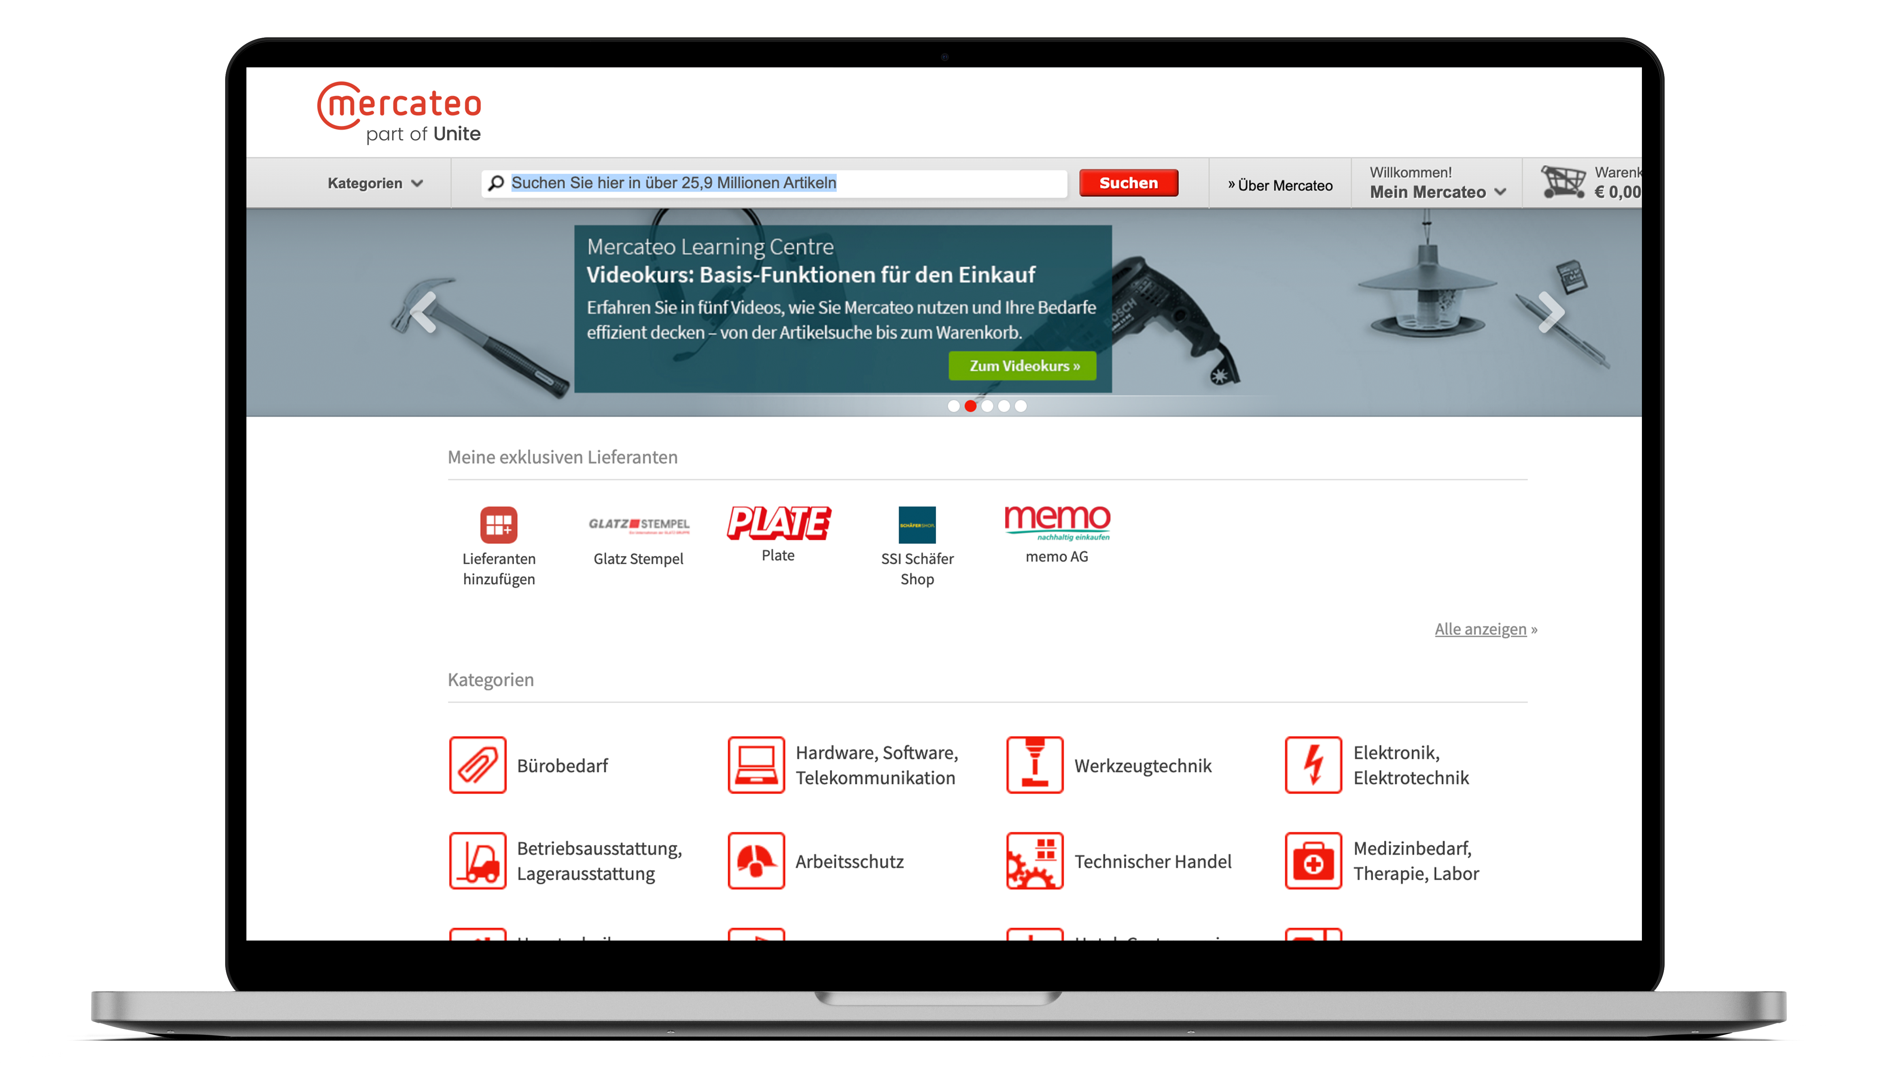
The Unite Platform with our Mercateo Procurement Portal
Create a customised purchasing experience
Instantly buy from our integrated B2B product assortment, our Spotmarket
Access the Unite Store and activate supplier catalogues
called BusinessShops
Buy from your activated BusinessShops alongside your framework catalogues, called BusinessShop Pluses

Slide 18
The Unite platform with our Mercateo Procurement Portal
Smart procurement features
    Built-in Spotmarket for ad-hoc spend - compare millions of products and hundreds of pre-vetted suppliers for easy, efficient purchasing
    Easy access to the Unite Store - curate a customised multi-supplier B2B marketplace by activating supplier BusinessShops
    Digital mapping of your framework agreements
    Control what’s included in product assortments and who can access them
    Powerful product search and filters across multiple catalogues
    Standalone user management* - allocate user/multi-user rights, spend controls and approval workflows
    Define billing and delivery addresses, cost centres and
    ledger codes
    Shopping basket optimisation - ensure best price and delivery across multiple suppliers at checkout
    Access order reports to analyse expenditure and identify potential savings with order and payments data (ECLASS, UNSPSC)
    Full compatibility with over 40 ERP and third-party solutions
* Applicable for web-based users

Slide 19






Mercateo Procurement Portal
Benefits for punchout customers
    Familiarity - buy from your suppliers as usual
    Compliance - adhere to compliance standards with ease
    Minimal effort - if your system is already supported,
    otherwise we’ll help you connect it
    Flexibility - transfer your network, contracts and creditors
    with ease when changing e-procurement systems
Just a few examples of ERP and e-procurement systems punching out to the Mercateo Procurement Portal

Slide 20
For API customers
Procure
Access our Unite Network and Spotmarket

Slide 21







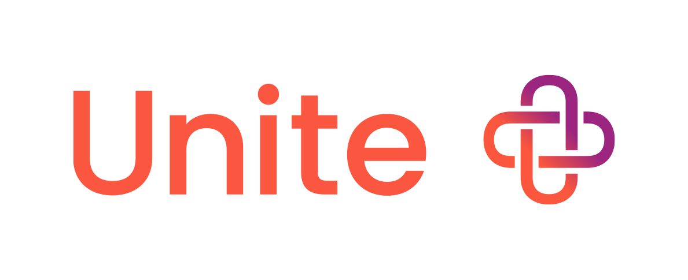







Unite Platform via API
Buyers
Combine the features of your preferred system
with access to the Unite Network and our Spotmarket
    Seamless integration via API
    Stay within your purchasing system
    Build and keep your network independent of your
    system provider
Your ERP/e-procurement system
API
Suppliers
Spotmarket

Slide 22
Better business buying
Activate
Procure
Buy
Find, activate suppliers and build your network.
Optimise procurement and steer internal demand.
Customise your B2B marketplace and decide how to shop.

Slide 23
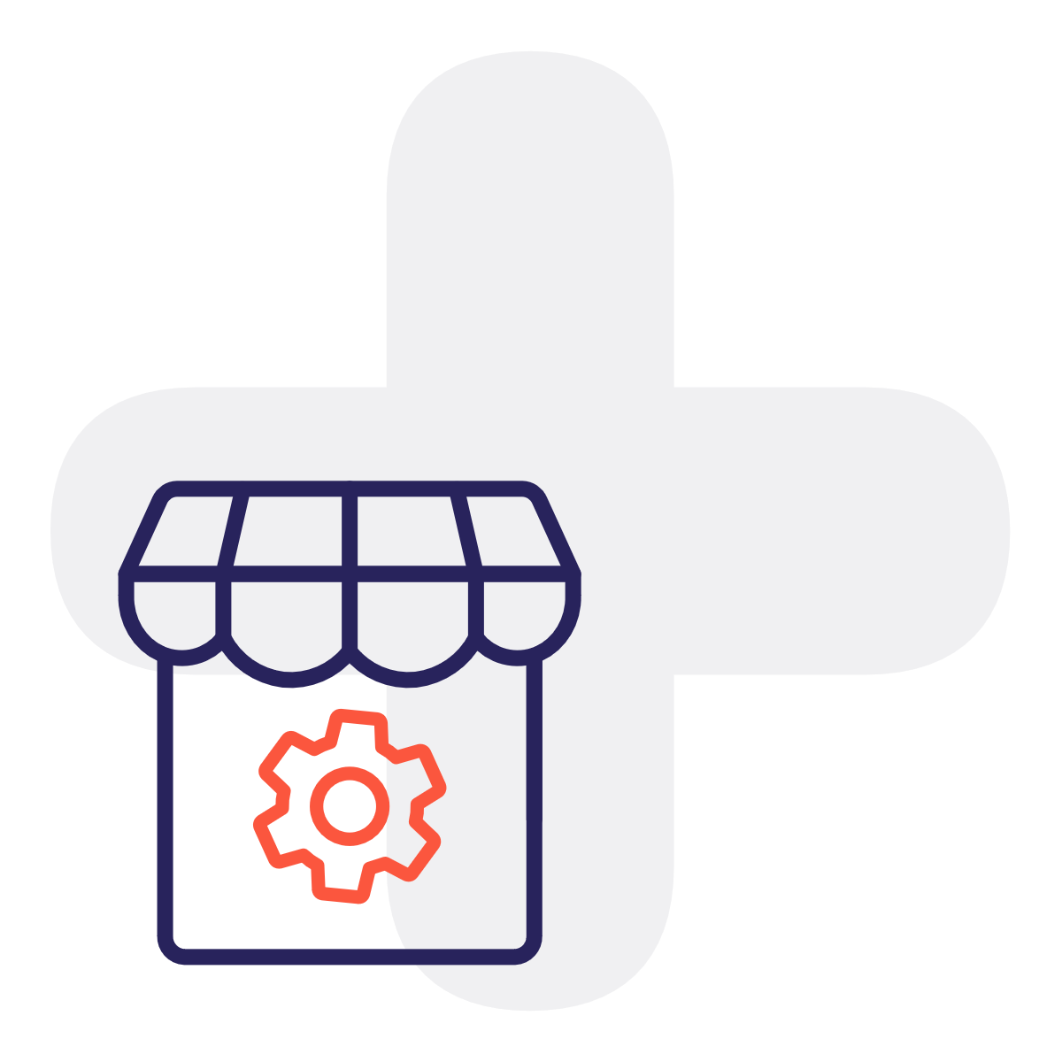

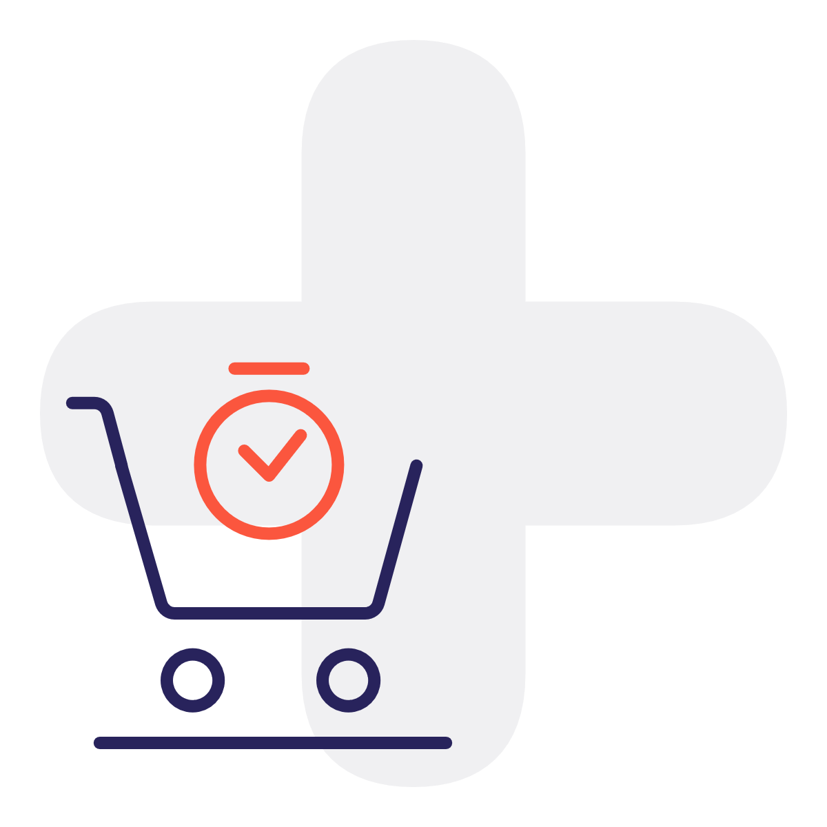
Buy
However you want to buy, we’ve got you covered
BusinessShop
    Pre-integrated digital catalogues in the Unite Store
    One-click activation to create your own customised B2B marketplace
    Negotiate one-to-one pricing with suppliers
BusinessShop Plus
    Negotiate one-to-one conditions or choose a special product assortment
    Get notified and approve catalogue changes
Spotmarket
    For your ad-hoc buying
    Over 100 million items across Europe
    Hundreds of pre-qualified suppliers

Slide 24
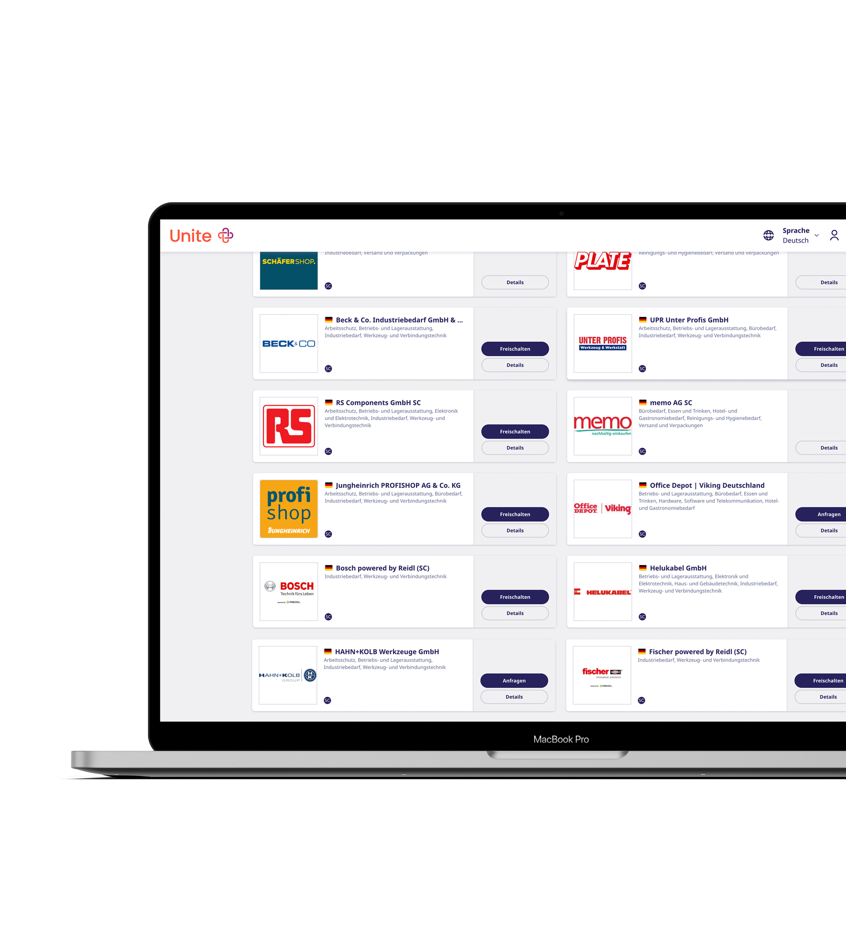
Buy
BusinessShop
  Take control of the way you buy with our BusinessShops
    Activate pre-integrated e-catalogues,
    called BusinessShops, with one click in the Unite Store
    Start buying from suppliers right away
    Negotiate prices and conditions – a BusinessShop offers enough space for individualisation
    Pricing transparency – benchmark your BusinessShop items against our integrated B2B Spotmarket

Slide 25













Buy
Spotmarket – more than xy (insert per market) categories
Stationery
Building services, engineering
Occupational safety
Professional tools
Hotel and catering supplies
Medical, therapy, and laboratory supplies
Office and warehouse equipment
Computers and accessories
Shipping, packaging
Industrial
Electronics
Other categories

Slide 26














Buy
Spotmarket – International coverage
Austria
17.1m items
Hungary
5.7m items
Spain
4.9m items
Belgium
6.9m items
Ireland
4m items
Switzerland
4.2m items
Czech Republic
6.1m items
Italy
7.9m items
The Netherlands
11.6m items
France
6.8m items
Poland
6.4m items
United Kingdom
6.4m items
Germany
26.1m items
Slovakia
5.1m items
Status: March 2023

Slide 27
Better business buying
Activate
Procure
Buy
Pay
Find, activate suppliers and build your network.
Optimise procurement and steer internal demand.
Customise your B2B marketplace and decide how to shop.
Capture indirect spend and simplify reconciliation.

Slide 28
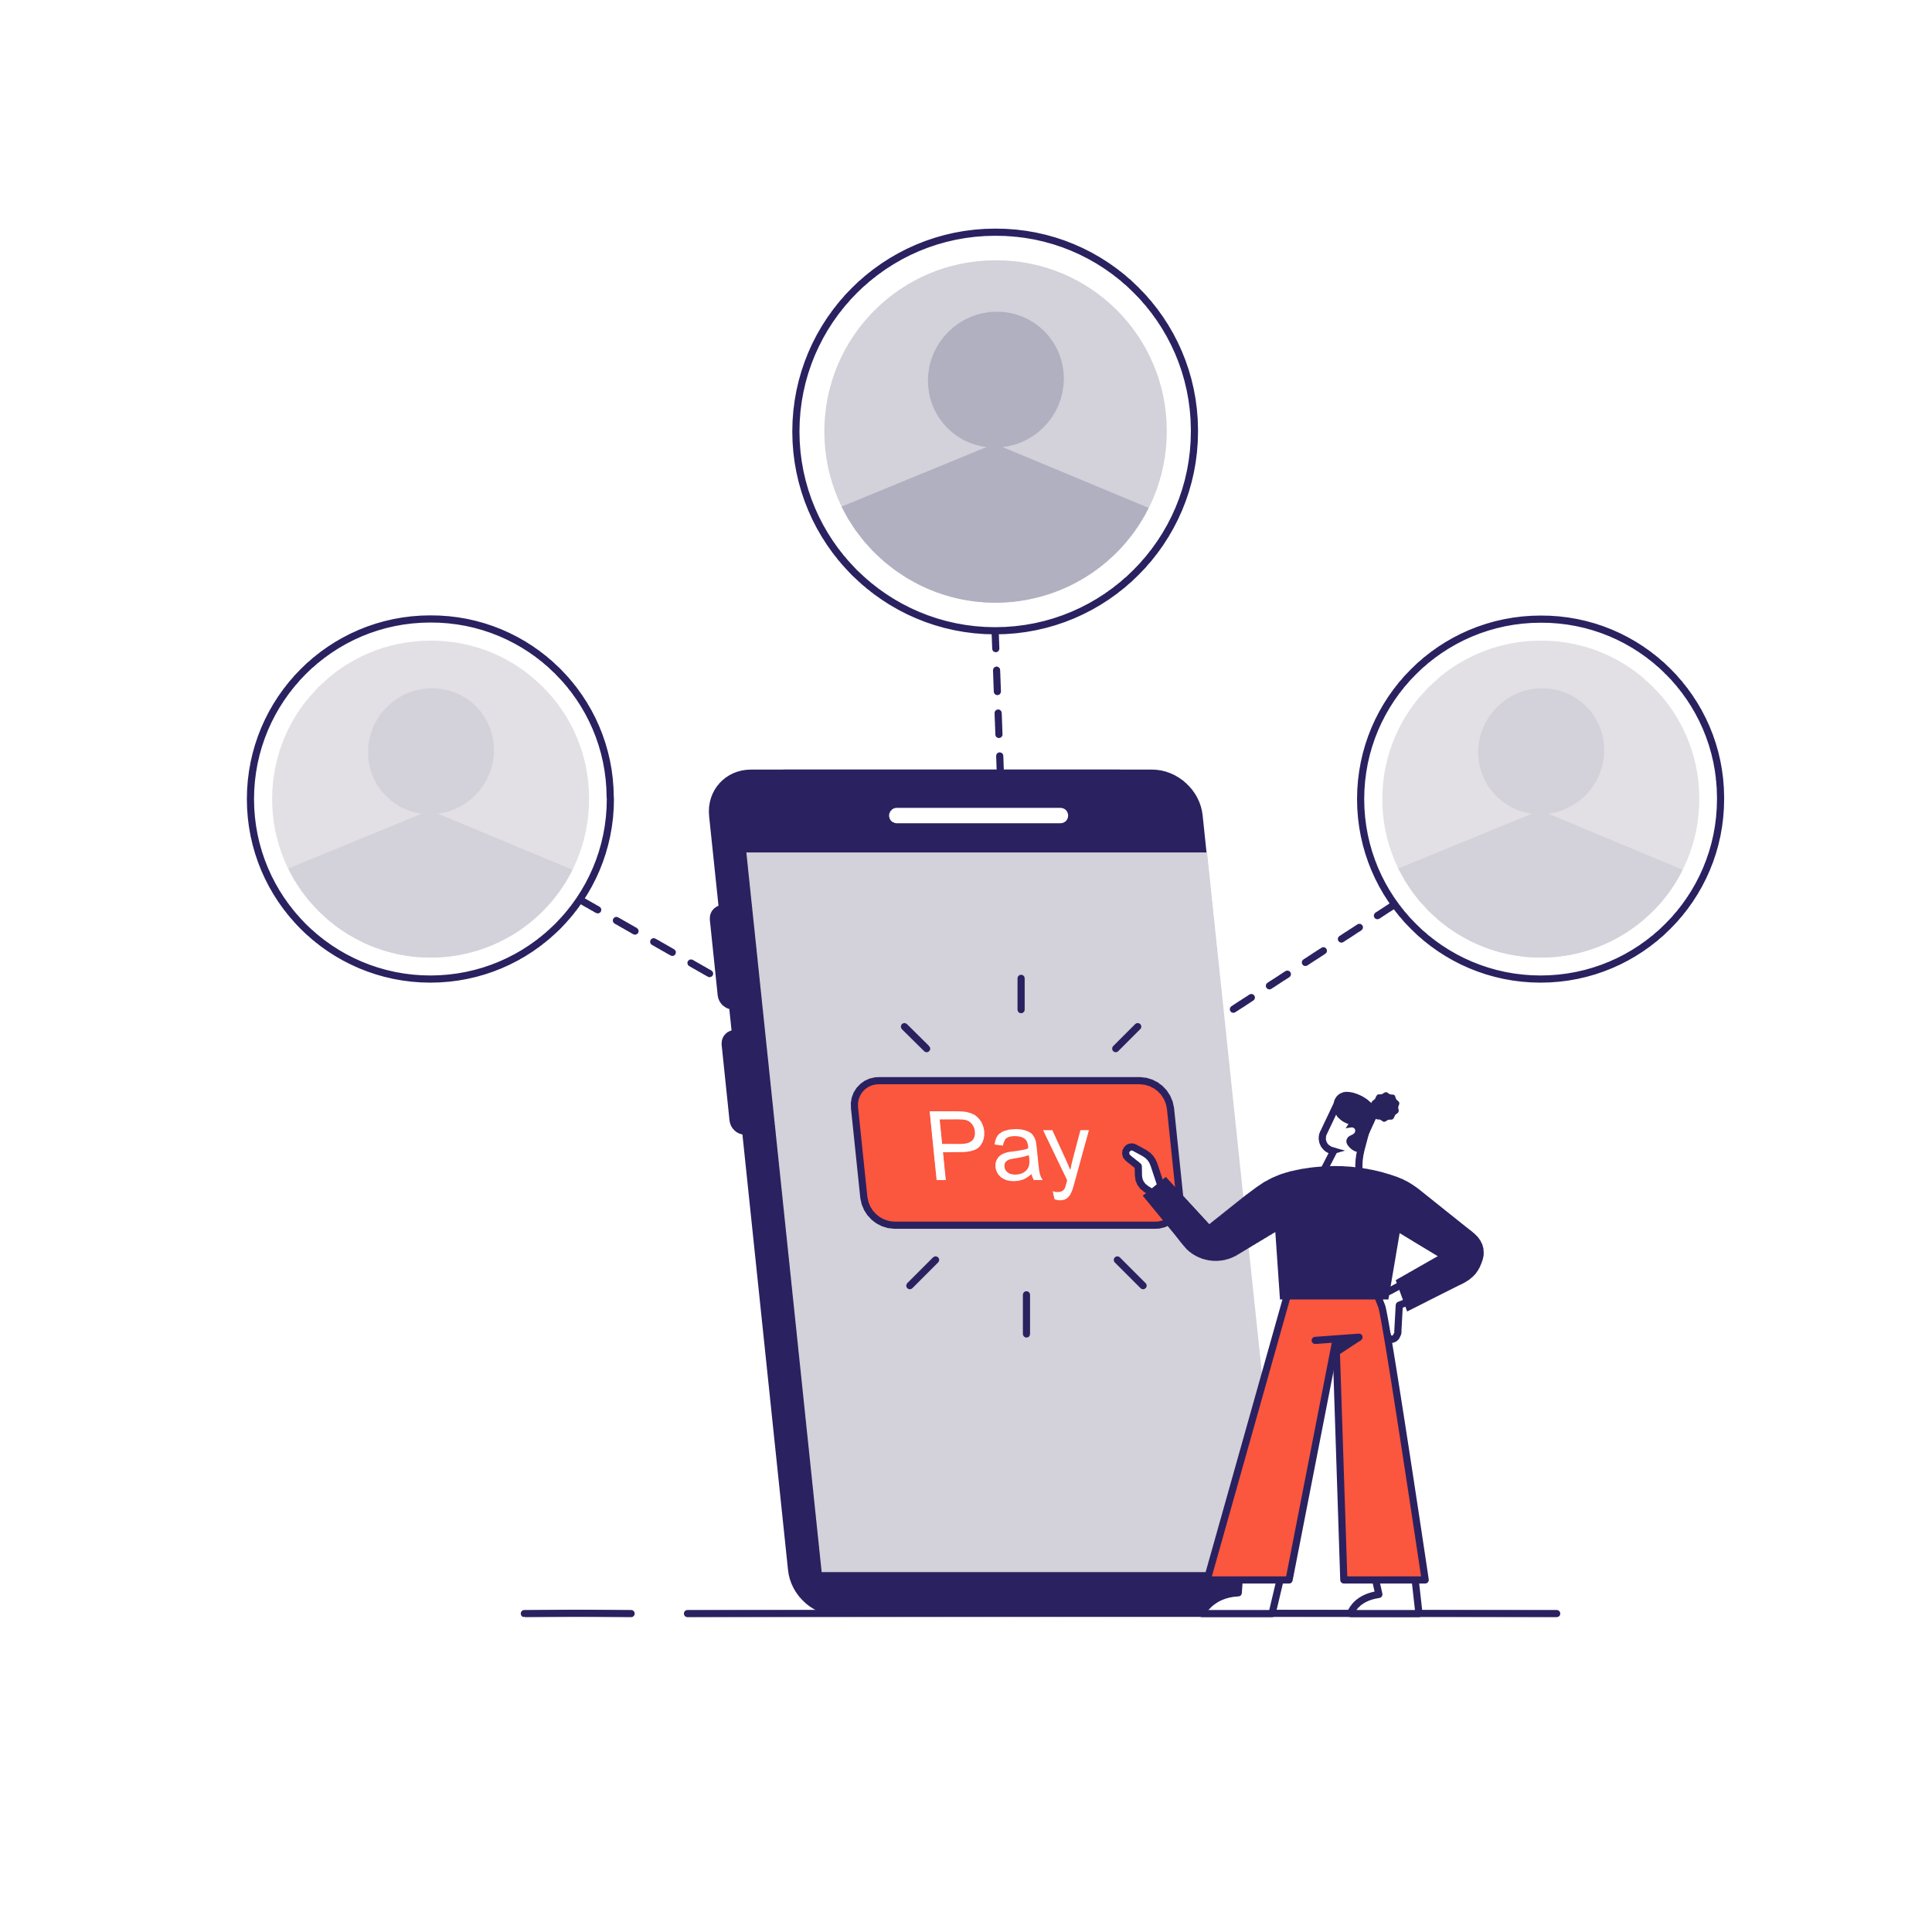
Pay
Payments made easy
    Make payments easier for your accounts team with our standardised digital invoicing
    Simplify invoice and payment processing with the
    Single Creditor*
    Use our analysis to keep an overview of expenditure
    Automate payment processing and e-invoicing to minimise the risk of accounting errors
    Use self-billing
    Enjoy flexible payment terms** with the
    Mercateo Procurement Portal
* Available for the Spotmarket and activated BusinessShops
** Only available in selected markets

Slide 29

Pay
Single Creditor
    One creditor, but as many suppliers as you want - place all your orders, from your activated single-creditor BusinessShops and our Spotmarket, through one Unite account
    Streamlined, accurate accounting - with accounts payable automation and e-invoicing
    Greater visibility of your spend - easy access to order and payments data helps you see the bigger picture
    Flexible payment terms to suit you - when buying via our Procurement Portal, you can extend your payment terms for up to 90 days
    Save time with self-billing - with VAT compliance
    and invoice checking taken care of*
* Available in select countries.

Slide 30

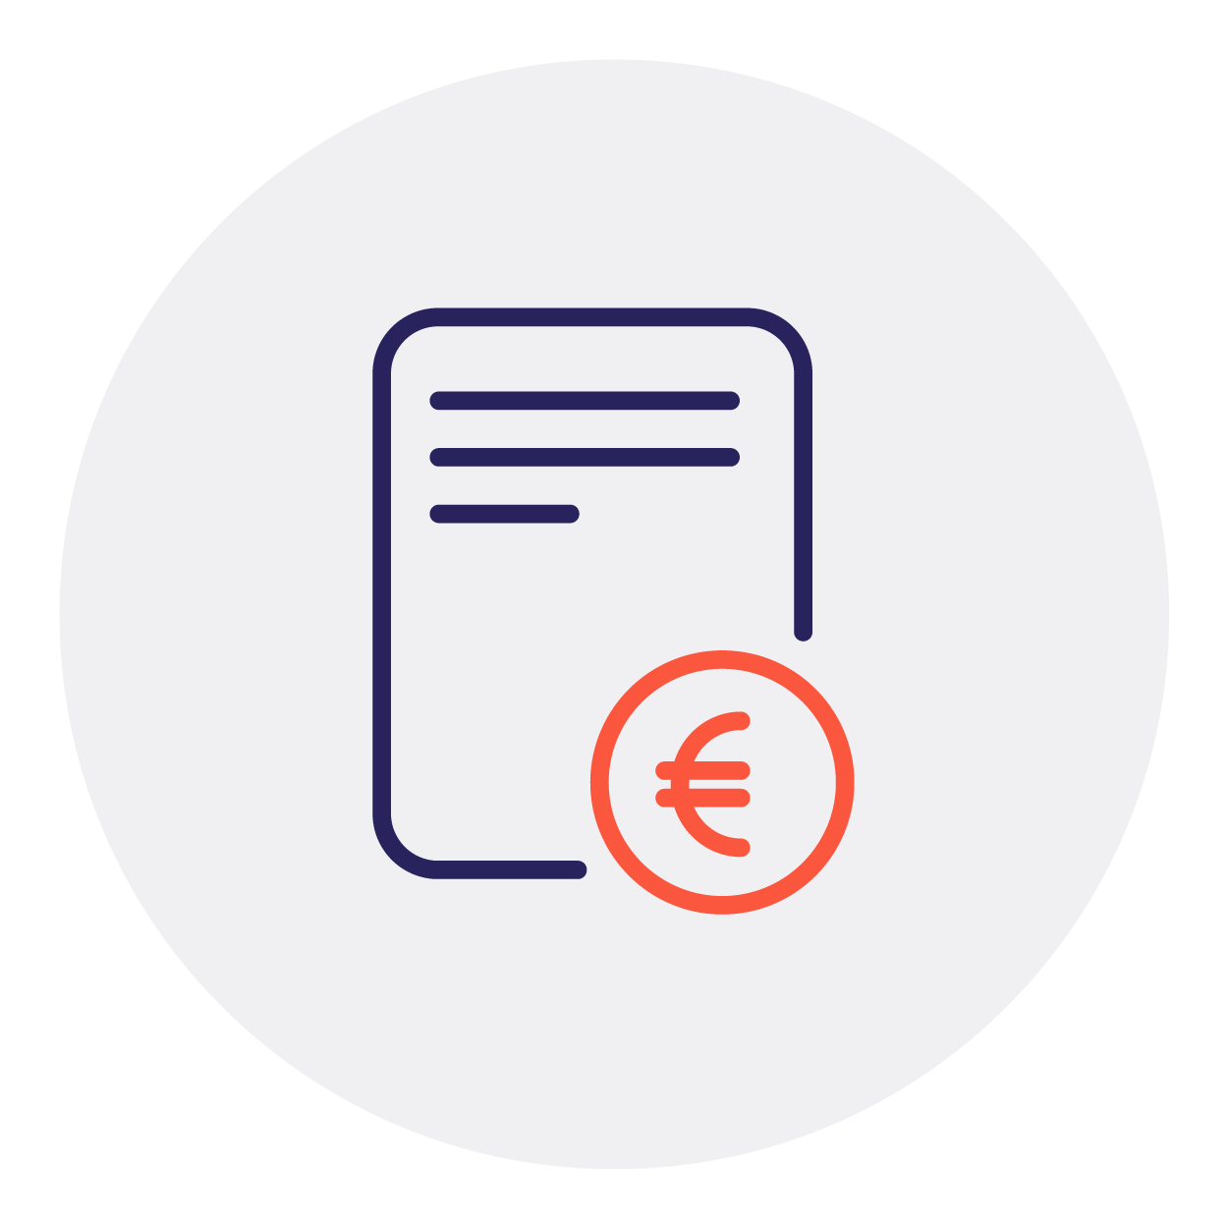
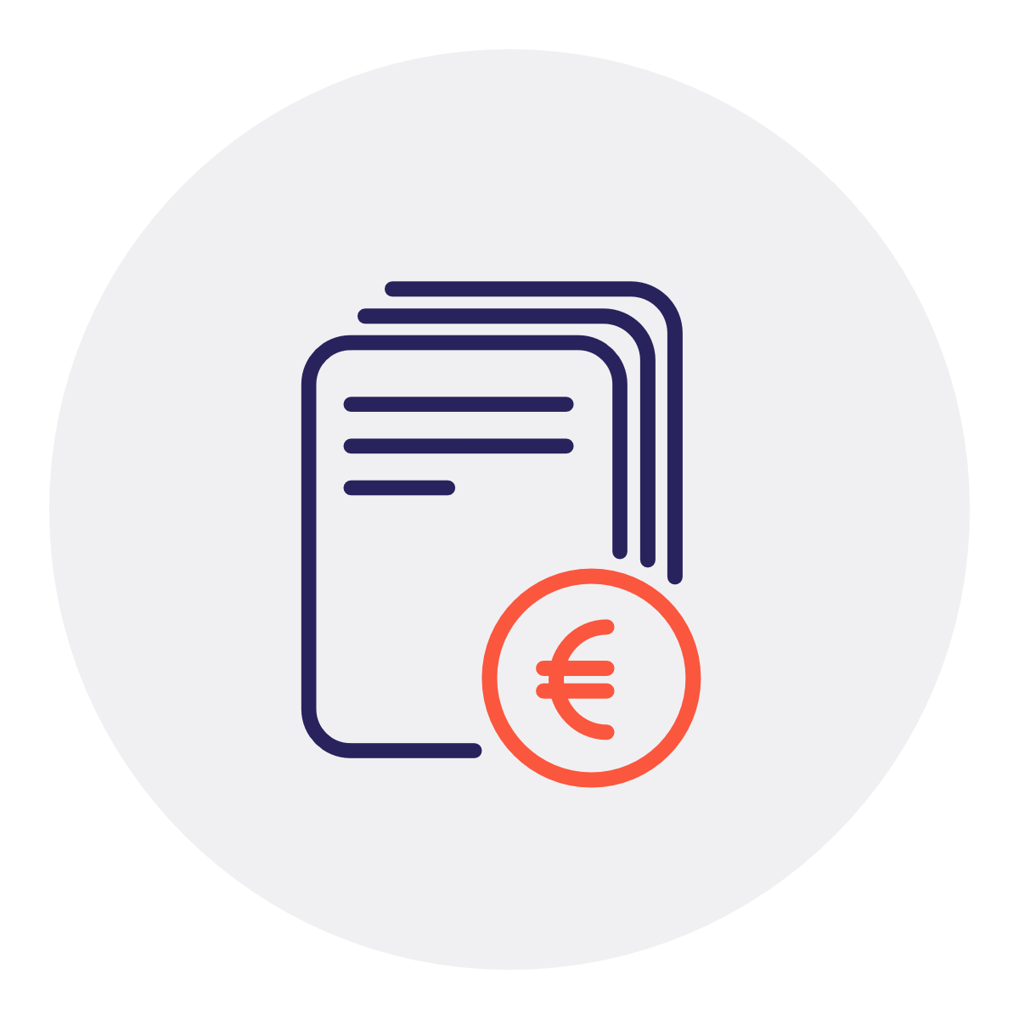
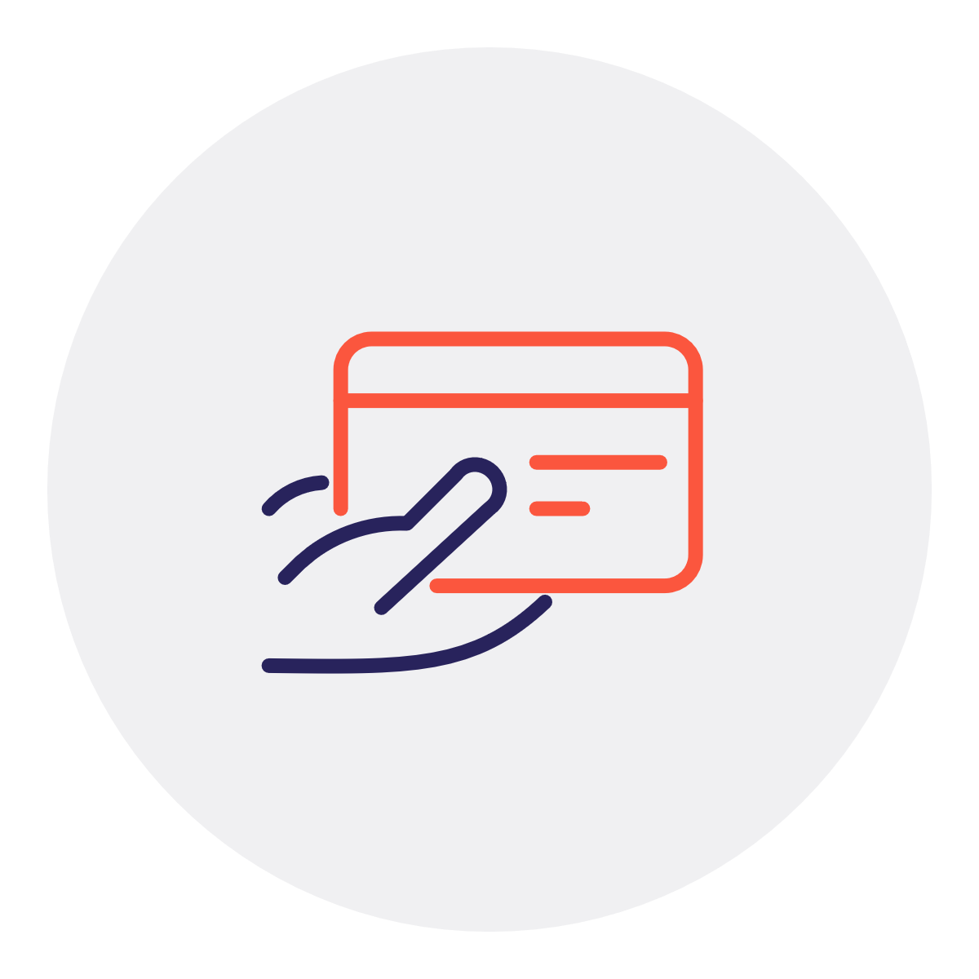

Pay
Single Creditor
Order
You place orders with single-creditor BusinessShops on Unite.*
Invoice
Your suppliers send their invoice data to Unite.
Bundle
We bring all your invoices together on one Unite account.
Pay
You pay your Unite invoice and we take care of the rest.
* Available for the Spotmarket and a select number of activated BusinessShops

Slide 31
Better business buying
Activate
Procure
Buy
Pay
Analyse
Find, activate suppliers and build your network.
Optimise procurement and steer internal demand.
Customise your B2B marketplace and decide how to shop.
Capture indirect spend and simplify reconciliation.
Get insights and support from ecosystem specialists.

Slide 32




Analyse
Reporting and data management
Comprehensive reports Analyse your operational spend using comprehensive reports (.csv/API/.xml).
Increased automation efficiency
Accelerate purchase-to-pay cycle times with frictionless integration using a punchout.
Smart insights and actionable data
Gain visibility into your tail spend and ad-hoc purchasing to identify savings.
Tail spend analysis and auditing
Capture and process spend data (ECLASS, UNSPSC) to ensure it is standardised and accurate.
* Available in select countries.

Slide 33
Contact
Do you have any questions?
First and last name
  Job title
  name.lastname@unite.eu
  +49 (0) 0000 00000

